Slide 1
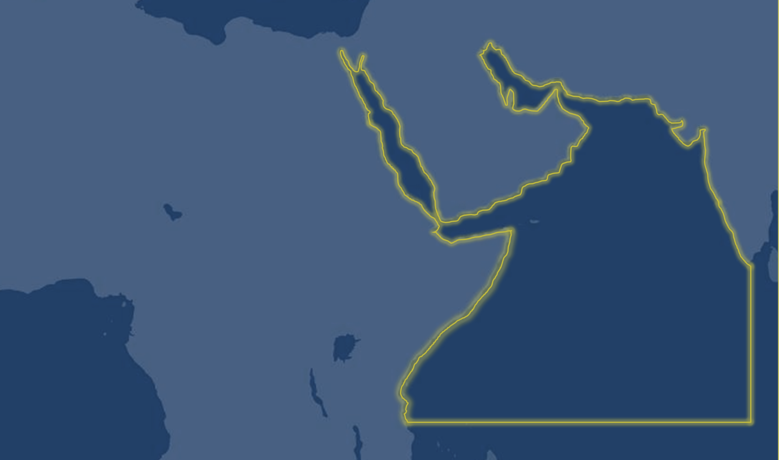
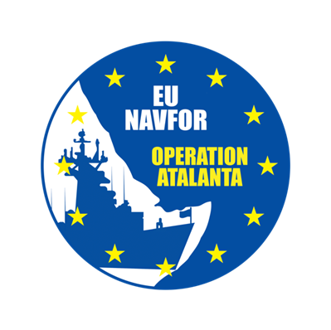




MSCIO ATALANTA
WEEKLY REPORT
05th Jun – 11th Jun
postmaster@mscio.eu 0033 (0) 298 220 220
https://mscio.eu/ 0033 (0) 298 220 170

Slide 2
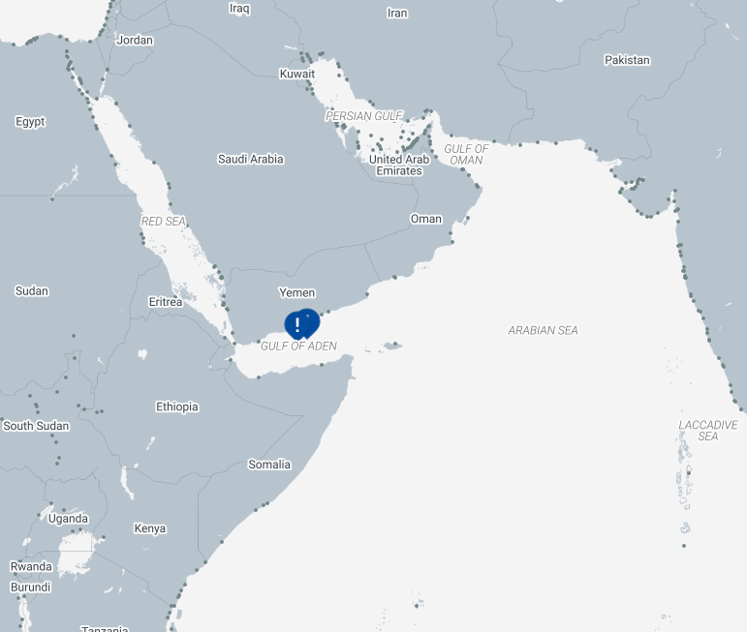



OVERVIEW OF INCIDENTS IN THE VOLUNTARY REPORTING AREA (VRA)
CATEGORY |  | No.
 | Armed Robbery | Nil
 | Attack | Nil
 | Attempted Boarding | Nil
 | Boarding | Nil
 | Hijack | Nil
 | Kidnap | Nil
 | Piracy | 3
 | Suspicious Activity | 2
 | Other Maritime Crimes | Nil
Total Incidents |  | 5

Slide 3
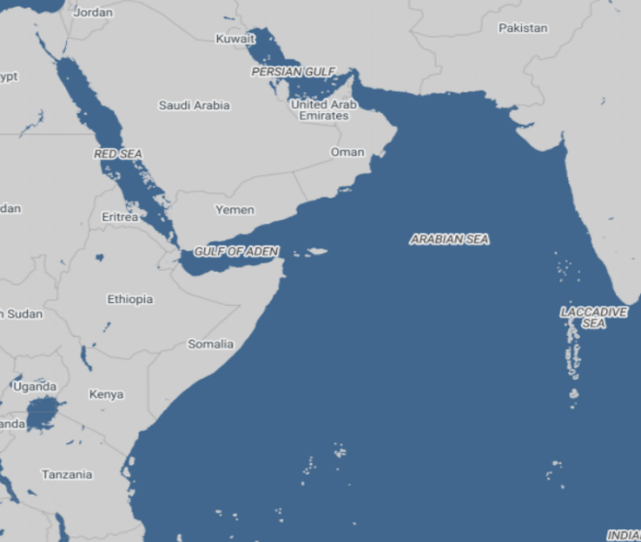
PIRACY
PIRACY
TYPE OF INCIDENT: PIRACY.
LOCATION: Horn of Africa, Somalia.
RELEVANT INFORMATION RELATED WITH THE EVENT:
Several piracy-related incidents continue to be monitored off the coasts of Somalia and Yemen. On 26 April, the merchant vessel M/V SWARD (IMO 9174244) was confirmed hijacked and remains under the control of armed individuals, with its latest reported position at 07°13’N 049°33’E. Operation ATALANTA also continues monitoring the hijacking of tanker M/T HONOUR 25 (IMO 1099735), first reported on 21 April, with the latest reported position at 08°55’N 050°33’E. Additionally, on 2 May, armed individuals reportedly boarded and hijacked tanker EUREKA (IMO 1022823) while at anchorage off Qana Port, Yemen; Operation ATALANTA later confirmed the vessel’s position at 09°50’N 050°54’E. Operation ATALANTA assets have also confirmed that the dhow hijacked on 25 April 2026 has been released and the crew is safe. All remaining incidents continue to be monitored by Operation ATALANTA assets in coordination with regional authorities, while vessels operating in the area are advised to maintain heightened vigilance, adhere to BMP-MS guidance, and report suspicious activity to MSCIO and UKMTO.

Slide 4
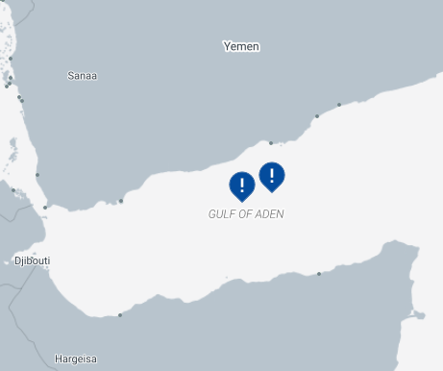
SUSPICIOUS ACTIVITY
PIRACY
TYPE OF INCIDENT: SUSPICIOUS ACTIVITY
LOCATION: Strait of Hormuz
RELEVANT INFORMATION RELATED WITH THE EVENT:
During the reporting period, two maritime security incidents were reported in the Gulf of Aden region. On 06 June 2026, approximately 100NM northwest of Bosaso, Somalia, two merchant vessels reported separate suspicious approaches by small craft carrying multiple persons onboard. In both cases, the approaching vessels disengaged after defensive measures, including the deployment of armed security personnel, were implemented. Subsequently, on 10 June 2026, a cargo vessel transiting approximately 88NM southwest of Balhaf, Yemen, reported an approach by a small craft carrying six armed persons onboard. An exchange of fire occurred between the small craft and the vessel’s Armed Security Team, after which the small craft withdrew from the area.

Slide 5
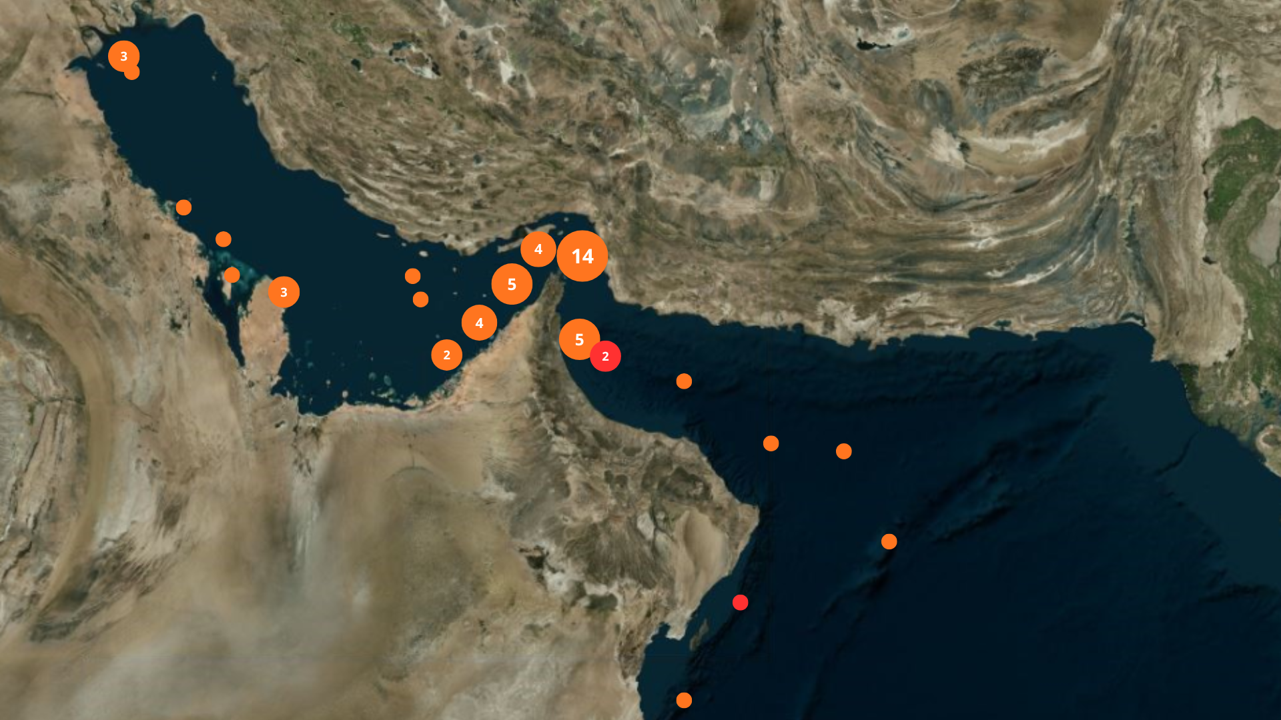
OVERVIEW OF INCIDENTS IN THE AS/SoH/GoO
SUMMARY OF INCIDENTS
UKMTO WARNING 064-26
UKMTO WARNING 066-26
UKMTO WARNING 067-26

Slide 6
ASSESSMENT AND GUIDANCE FOR AS/SoH/GoO
• The maritime security environment in the Arabian Gulf, Strait of Hormuz and Gulf of Oman remains assessed as SEVERE. Navigation interference, blockade-enforcement activity and residual kinetic threats continue to create a volatile operating environment. Merchant traffic through the Strait of Hormuz remains significantly reduced, with many vessels continuing to route south of the TSS through Omani territorial waters.
• A NAVAREA IX warning (180/26) remains in force following reports of a suspected floating mine in position 26°24.3’N 056°20.6’E. Mine-risk reporting continues to apply within and adjacent to the TSS. Vessels transiting the area should maintain heightened vigilance and navigate with caution.
• Merchant vessels continue to report a strong multinational naval presence throughout the Gulf of Oman. Blockade-enforcement activity remains ongoing and verification hails directed at vessels approaching the Strait of Hormuz or operating to and from Iranian ports remain highly likely.
• GNSS interference, AIS anomalies and spoofing continue to affect the Strait of Hormuz approaches, Gulf of Oman, Arabian Gulf and adjacent waters. Mariners should be prepared to navigate using radar, visual observations and alternative navigation methods whenever necessary.
• It is advised for merchant vessels to:
- Conduct voyage-specific threat and risk assessments.
- Strictly adhere to BMP-MS and relevant Industry Guidance.
- Maintain continuous monitoring of VHF Ch16 and official reporting channels.
- Ensure bridge teams are prepared for GNSS degradation, spoofing and AIS anomalies.
- Maintain maximum possible distance from military units.
- Avoid unnecessary reductions in speed and minimise stationary periods where operationally feasible.
- Report suspicious activity, electronic interference and security incidents immediately to MSCIO and UKMTO.

Slide 7
ASSESSMENT AND GUIDANCE FOR RED SEA/BeM
• The maritime threat level in the Gulf of Aden, Bab el-Mandeb and Southern Red Sea remains MODERATE. Commercial traffic continues steadily through the area and no confirmed attacks on merchant shipping have been reported during the latest reporting period.
• Houthi messaging and hostile rhetoric continue without associated operational indicators, while the potential for renewed disruption remains should regional tensions escalate. Merchant vessels should continue to consider possible exposure based on ownership, cargo, Flag State affiliations or perceived associations with countries of interest.
• GNSS interference remains a residual hazard across the central Red Sea, with periodic effects extending into the southern sector and Bab el Mandeb approaches. Mariners should verify positions using alternative navigation methods when required.
• It is advised for merchant vessels to:
- Maintain navigation through international waters for as long as possible.
- Navigate closer to the African coastline where feasible and operationally appropriate.
- Maintain close coordination with MSCIO, UKMTO and relevant maritime security reporting centers.
- Conduct voyage-specific risk assessments and strictly adhere to BMP-MS.
- Monitor electronic interference and verify navigation data through radar and visual cross-checks.
- Review vessel affiliations, cargo exposure and ownership considerations prior to transit.
- Maintain enhanced vigilance and report suspicious activity immediately to MSCIO and UKMTO.

Slide 8
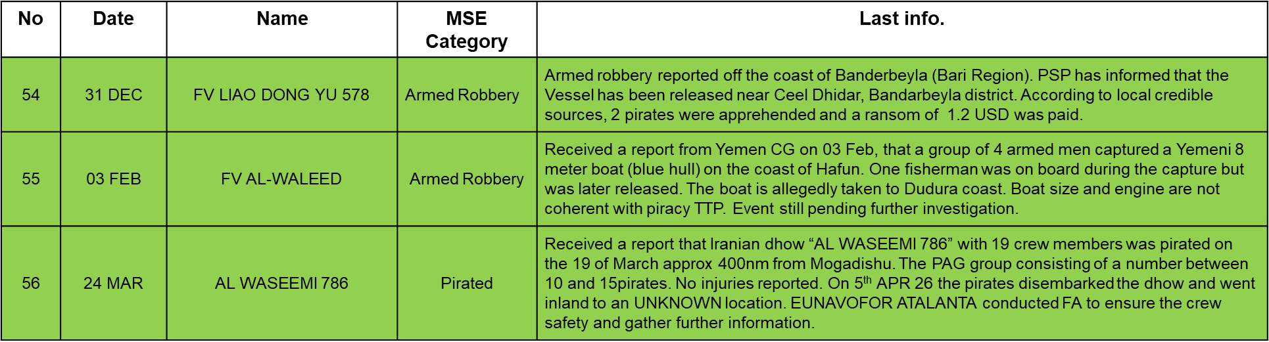

MARITIME SECURITY EVENTS RELATED TO PIRACY
(STATUS AND DETAILED DESCRIPTION FROM JAN 2026)

Slide 9
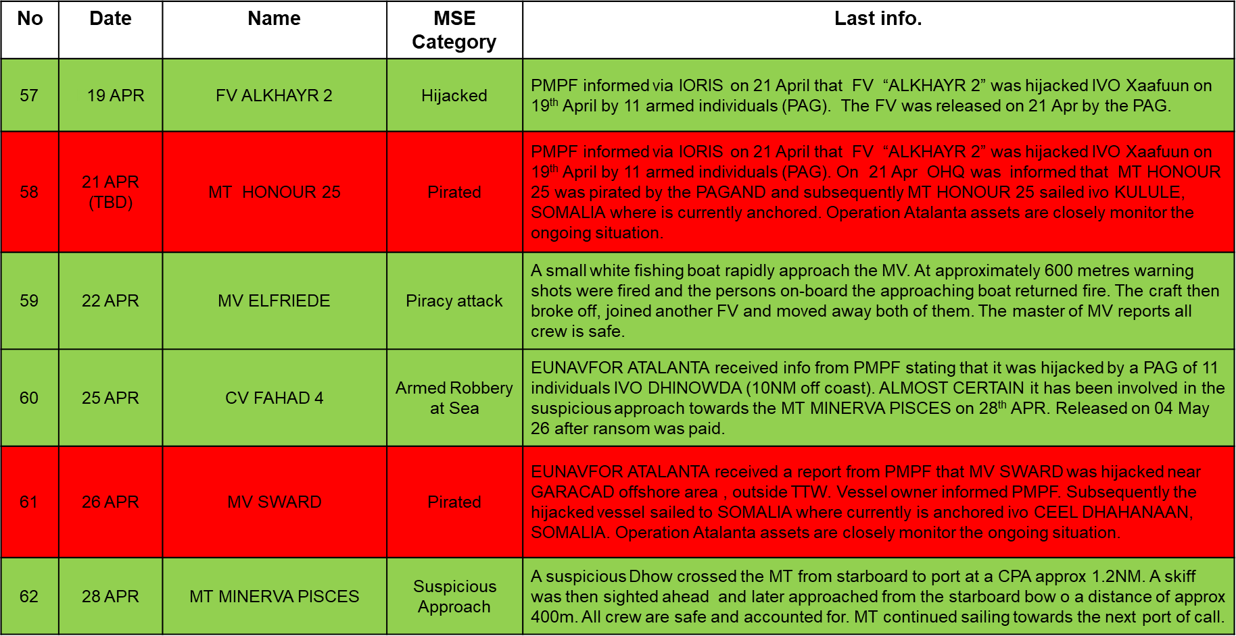

MARITIME SECURITY EVENTS RELATED TO PIRACY
(STATUS AND DETAILED DESCRIPTION FROM JAN 2026)

Slide 10
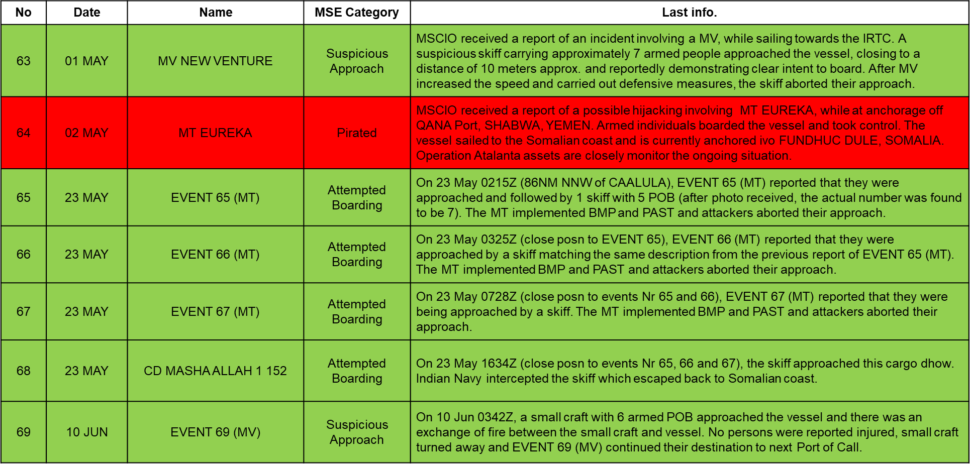
MARITIME SECURITY EVENTS RELATED TO PIRACY
(STATUS AND DETAILED DESCRIPTION FROM JAN 2026)

Slide 11
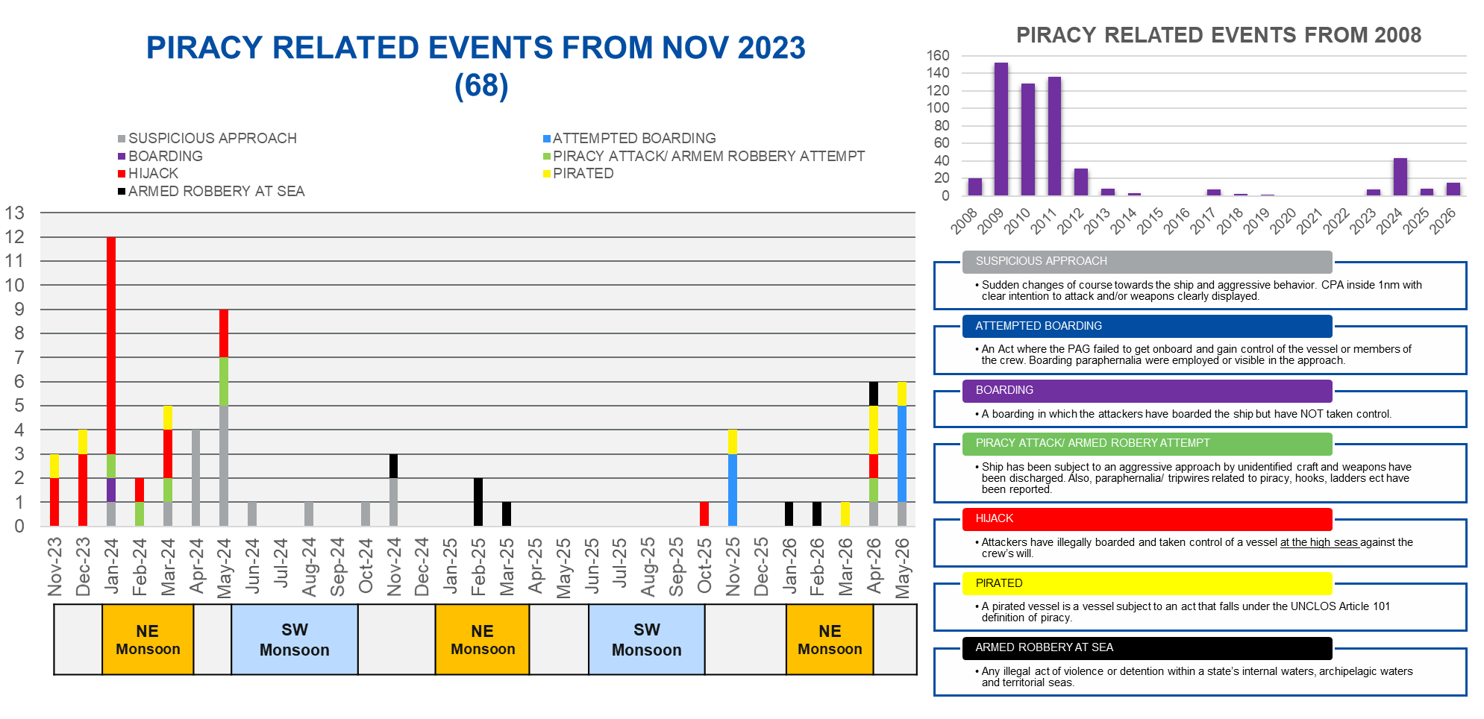
PIRACY STATISTICS (NOV 2023 – MAY 2026)

Slide 12
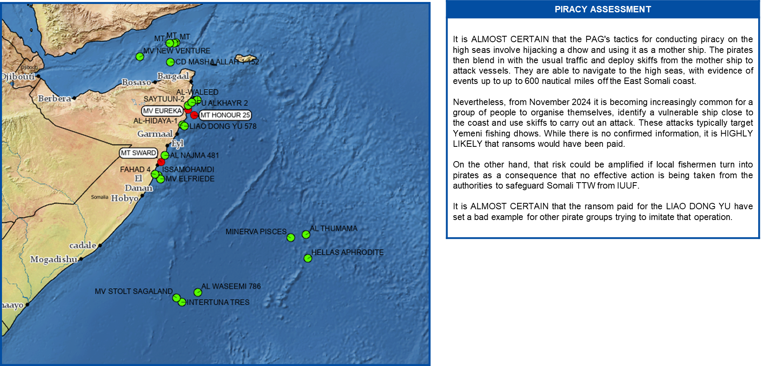
PIRACY SITUATION (JAN 2025 – MAY 2026)

Slide 13
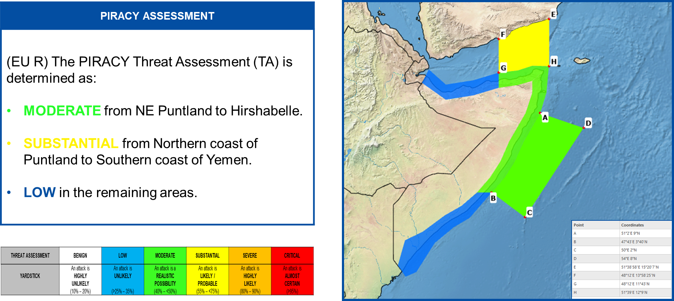
PIRACY THREAT ASSESSMENT

Slide 14
REGISTRATION AND REPORTING
REGISTRATION AND REPORTING. CSO's and Masters are encouraged to register their vessels upon entering the UKMTO Voluntary Reporting Area with both: - MSCIO (https://mscio.eu/reporting/vessel-registration/) - UKMTO (https://www.ukmto.org/reporting-formats/initial-report) And to report all incidents to UKMTO and MSCIO. When safe to do so, vessels should document incidents and suspicious activity through logs, photographs, video, and radar footage. CSOs should gather information on Pattern of Life and Maritime Situational Awareness for their planned routes and ports of call to support risk assessments. These procedures enable effective monitoring and resource allocation by CMF and EUNAVFOR ATALANTA.
Contact Information (MSCIO): Tel: 0033 (0) 298 220 220 // 0033 (0) 298 220 170 Website: www.mscio.eu Email: postmaster@mscio.eu

Slide 15
